Slide 1
Banking Management
System
Menudriven application

Slide 2
AIM
Banking management system is used to manage the details of customer account.
Customer can perform following operations:
OPEN ACCOUNT
DEPOSIT AMOUNT
WITHDRAW BALANCE
BALANCE ENQUIRY
DISPLAY CUSTOMER DETAILS
UPDATE RECORDS
CLOSE AN ACCOUNT
EXIT

Slide 3
REQUIREMENTS
Xampp server mysql
Vscode to write python code
Libraries used:
Pymysql
Windows 11

Slide 4
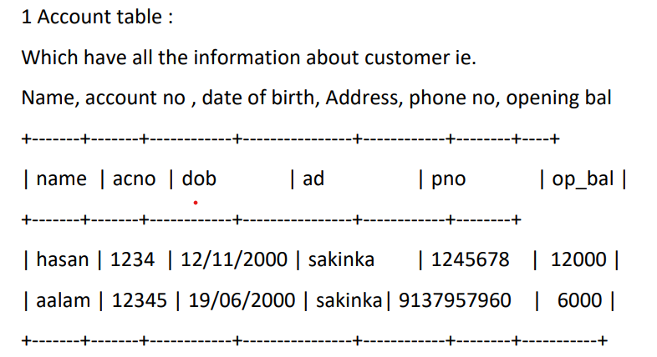
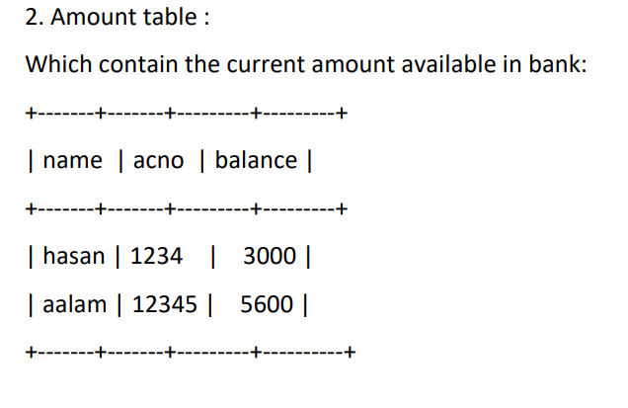
TABLES

Slide 5
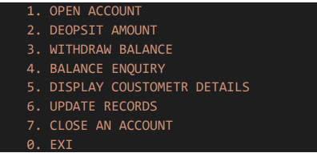
OUTPUT

Slide 6
CONCLUSION
This Bank Management System will provide the transaction which is actually going on in a bank by which you can perform all the transactions in simple manner.
All information will be updated automatically by using the information stored in the system files.

Slide 7
Thank You…

